Slide 1
Hurtownie Danych
SSISDB, SQL Agent, Jobs

Slide 2
SSISDB

Slide 3
Integration Services Server
After you design and test packages in SQL Server Data Tools, you can deploy the projects that contain the packages to the Integration Services server.
The Integration Services server is an instance of the SQL Server Database Engine that hosts the SSISDB database. The database stores the following objects: packages, projects, parameters, permissions, server properties, and operational history.
The SSISDB database exposes the object information in public views that you can query. The database also provides stored procedures that you can call to manage the objects.
Before you can deploy the projects to the Integration Services server, you need to create the SSISDB catalog.
https://docs.microsoft.com/en-us/sql/integration-services/catalog/integration-services-ssis-server-and-catalog

Slide 4
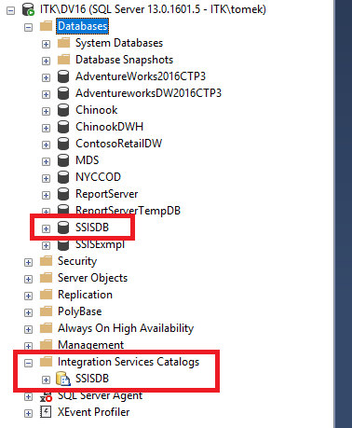
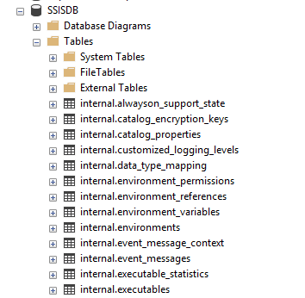
Integration Services Server
https://technet.microsoft.com/en-us/library/gg471509(v=sql.110).aspx

Slide 5
SSISDB
The SSISDB catalog is the central point for working with Integration Services (SSIS) projects that you’ve deployed to the Integration Services server. For example, you set project and package parameters, configure environments to specify runtime values for packages, execute and troubleshoot packages, and manage Integration Services server operations.
The objects that are stored in the SSISDB catalog include projects, packages, parameters, environments, and operational history.
https://docs.microsoft.com/en-us/sql/integration-services/catalog/ssis-catalog

Slide 6
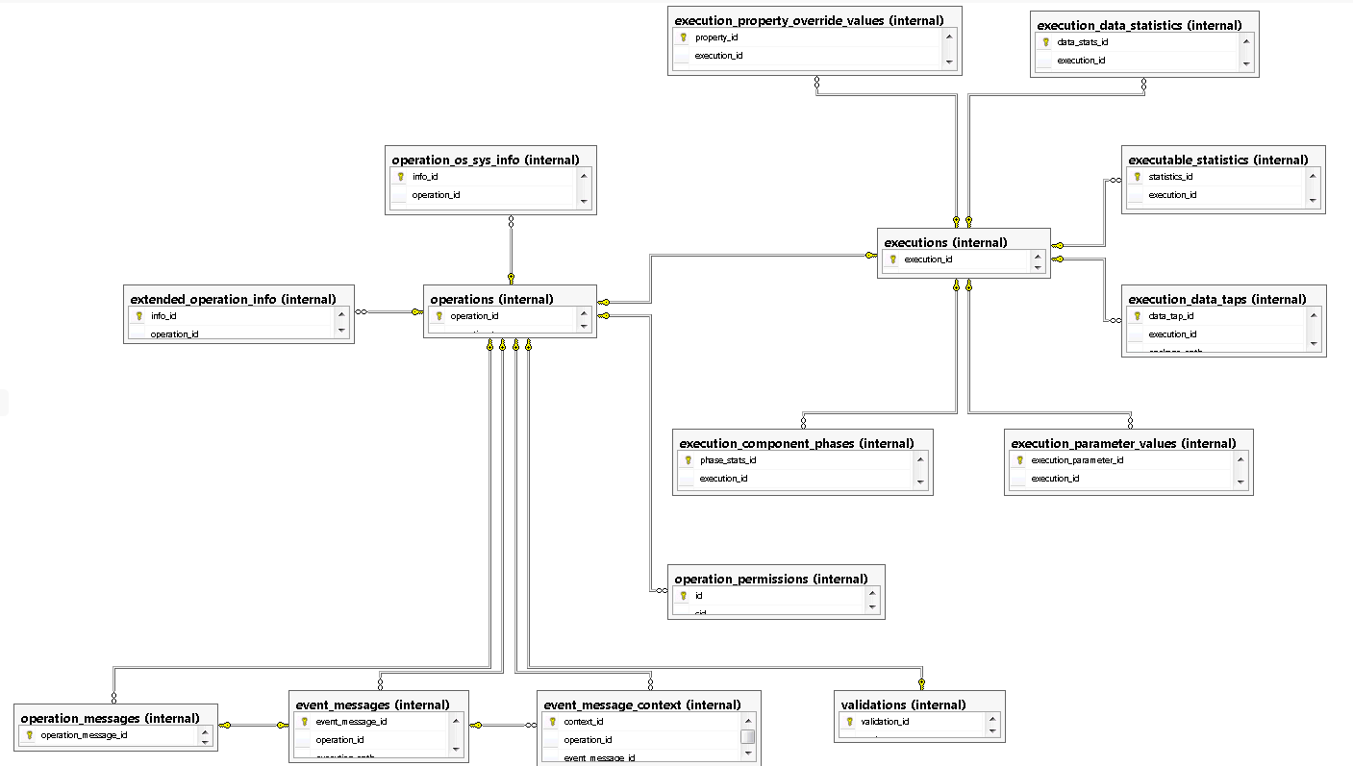
SSISDB

Slide 7
Deploy, Execution

Slide 8
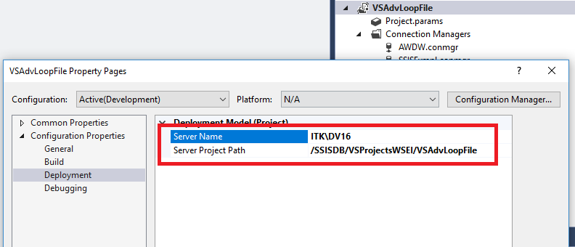
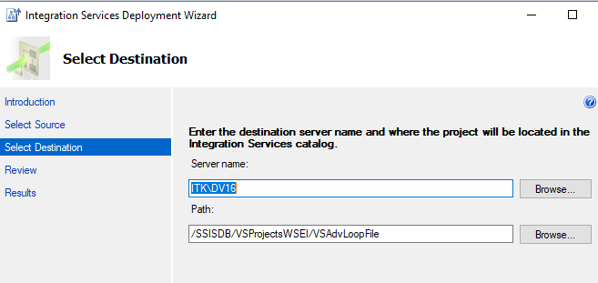
Project Deployment

Slide 9
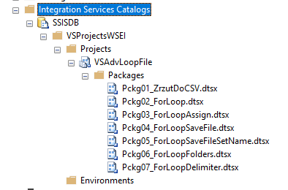
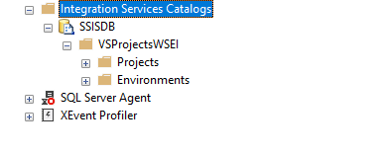
Project Deployment
deploy

Slide 10
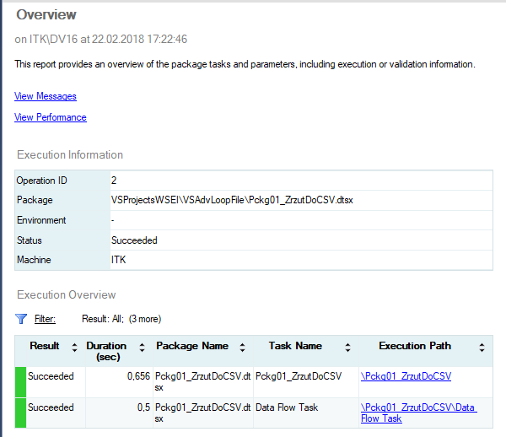
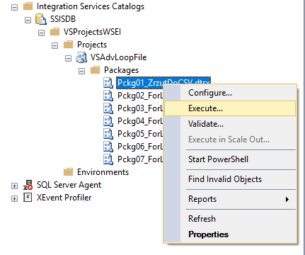
Execute from SSMS
execute

Slide 11
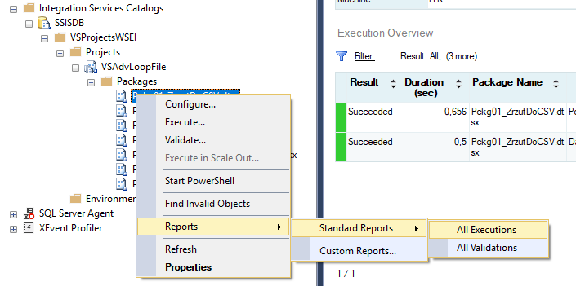
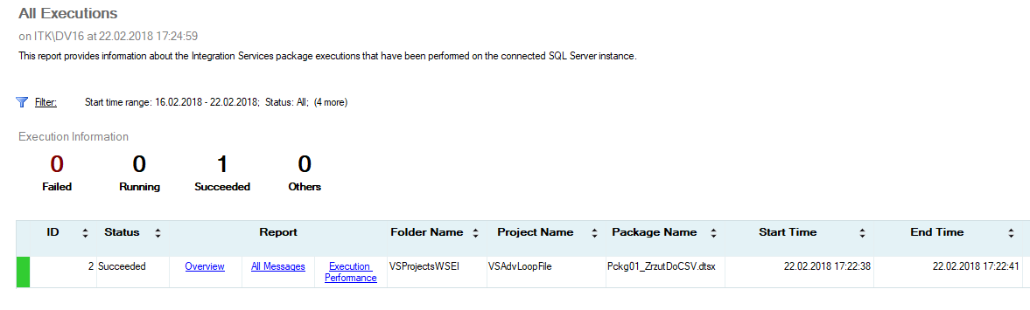
Execute from SSMS

Slide 12
Parameters, Environments

Slide 13
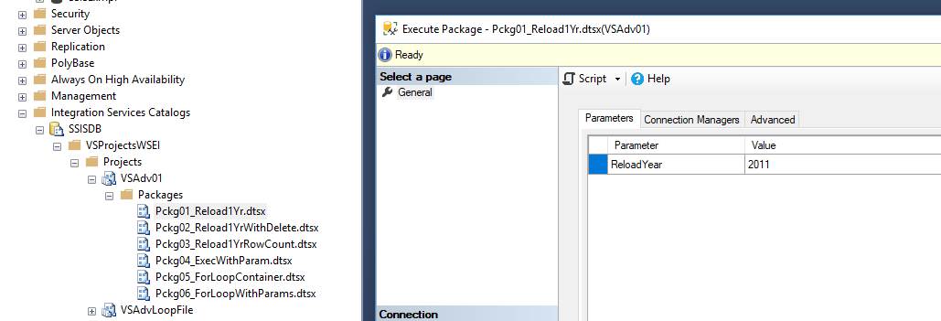
Parameters Configuration

Slide 14
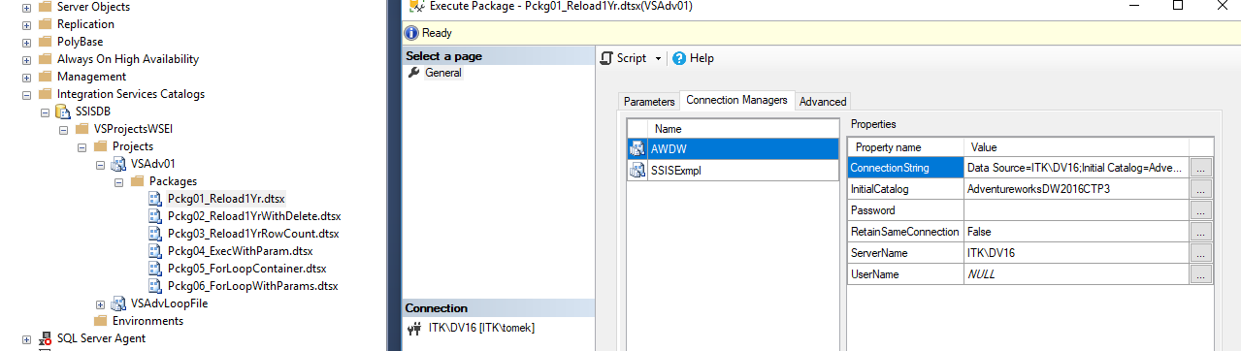
Connection Managers Configuration

Slide 15
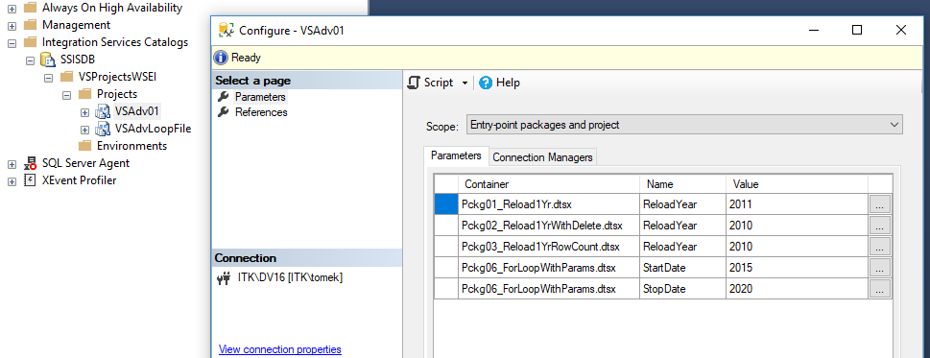
Environments

Slide 16
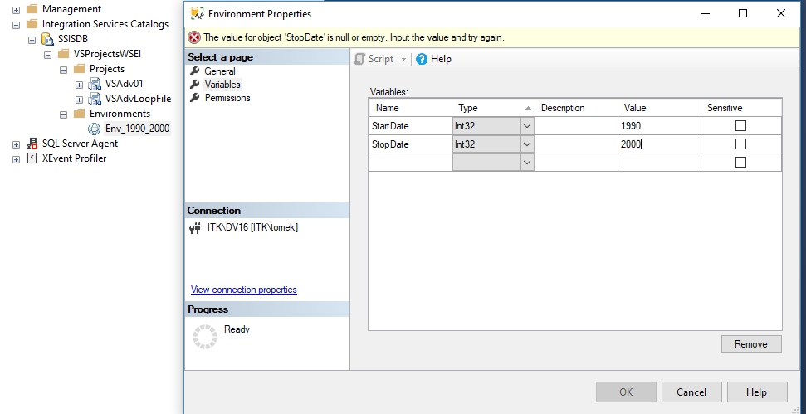
Environments

Slide 17
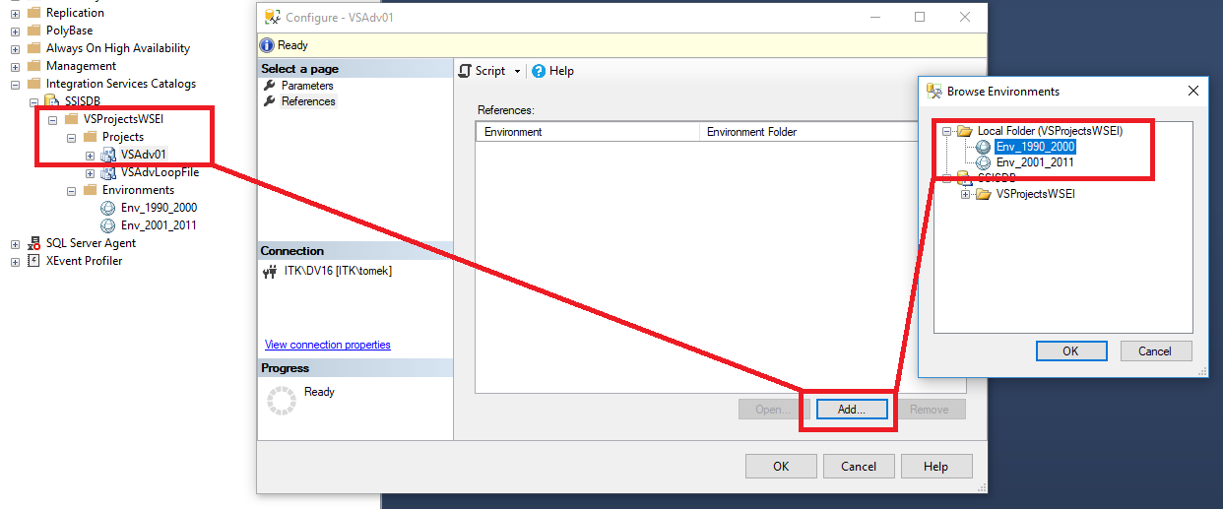
Environments

Slide 18
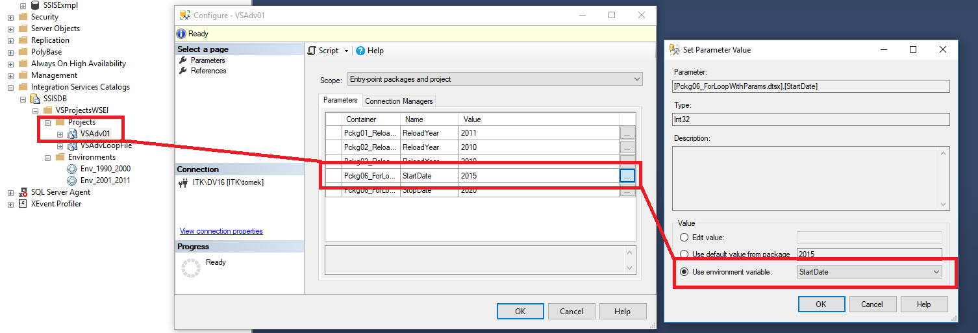
Environments

Slide 19
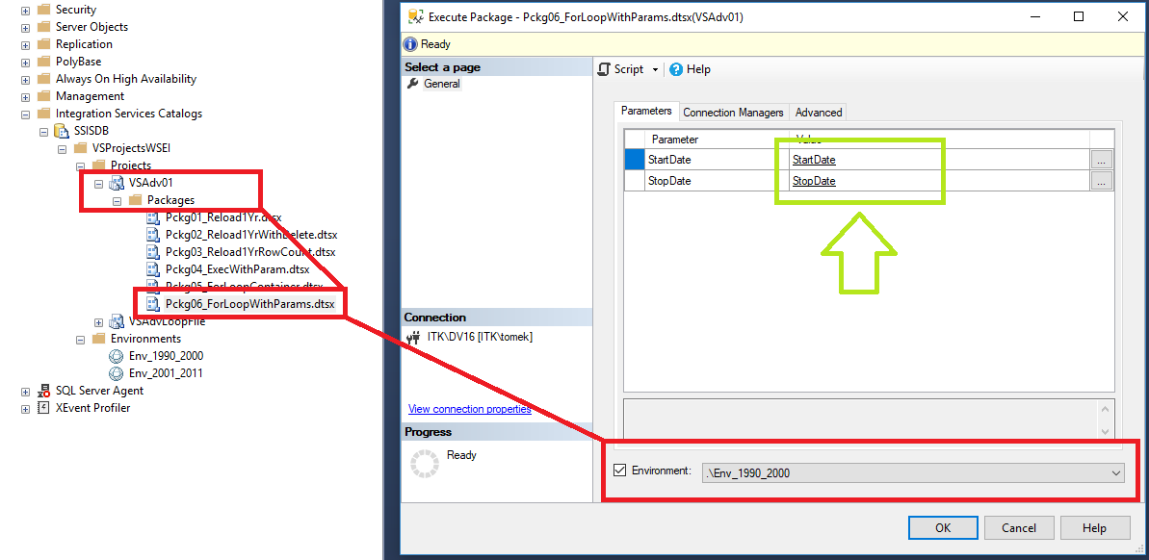
Execute Package + Environment

Slide 20
SQL Agent

Slide 21
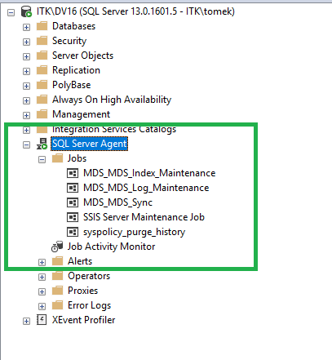
SQL Server Agent
SQL Server Agent is a Microsoft Windows service that allows you to automate some administrative tasks.
SQL Server Agent runs jobs, monitors SQL Server, and processes alerts. The SQL Server Agent service must be running before local or multiserver administrative jobs can run automatically.
The msdb database is used by SQL Server Agent for scheduling alerts and jobs and by other features such as SQL Server Management Studio, Service Broker and Database Mail.

Slide 22
Jobs, Schedules

Slide 23
Jobs & Steps
A job is a specified series of actions that SQL Server Agent performs. Use jobs to define an administrative task that can be run one or more times and monitored for success or failure. A job can run on one local server or on multiple remote servers.
Each action in a job is a job step. For example, a job step might consist of running a Transact-SQL statement, executing an SSIS package, or issuing a command to an Analysis Services server. Job steps are managed as part of a job.
Each job step runs in a specific security context. For other types of job steps, use a proxy account to set the security context for the job step.

Slide 24
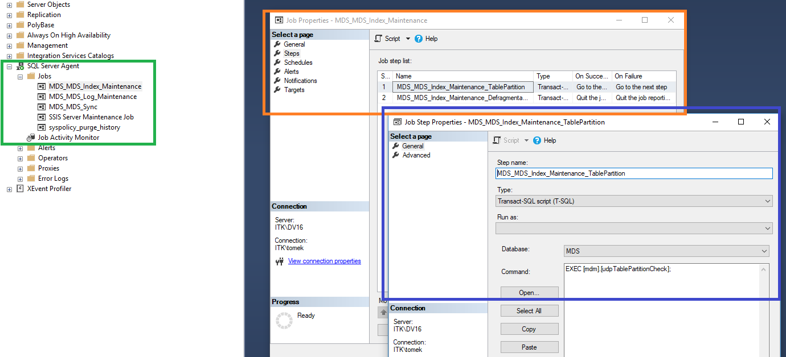
Jobs & Steps

Slide 25
Schedules
A schedule specifies when a job runs. More than one job can run on the same schedule, and more than one schedule can apply to the same job. A schedule can define the following conditions for the time when a job runs:
Whenever SQL Server Agent starts.
Whenever CPU utilization of the computer is at a level you have defined as idle.
One time, at a specific date and time.
On a recurring schedule.

Slide 26
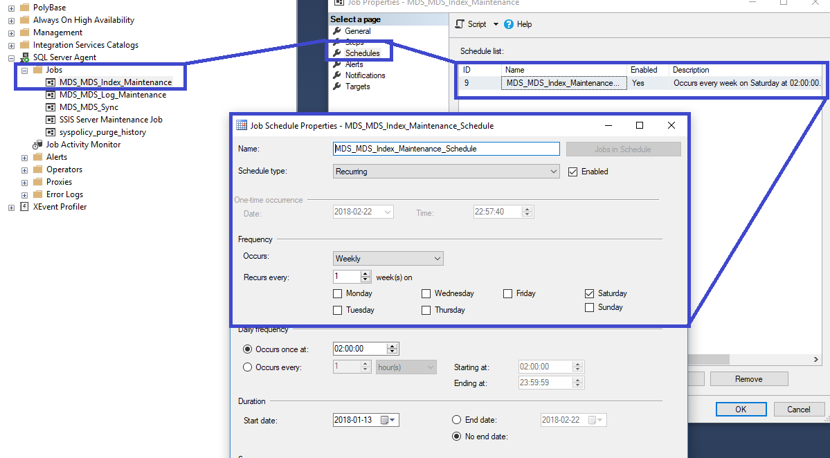
Schedules

Slide 27
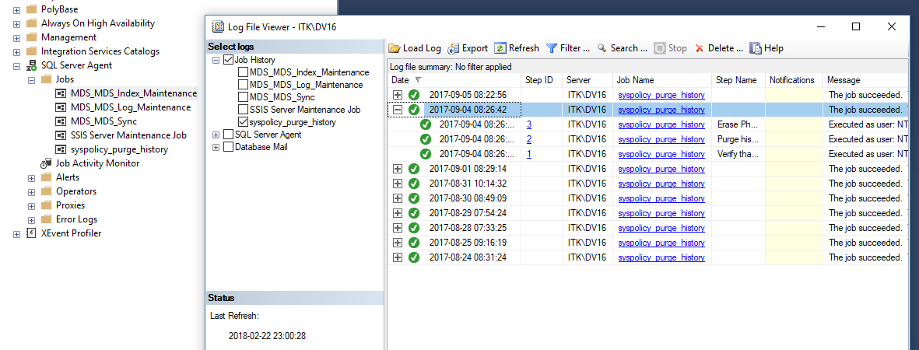
Execution History

